Slide 1
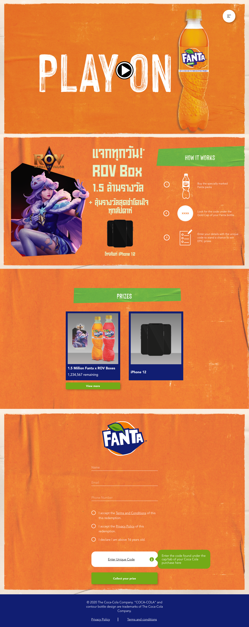


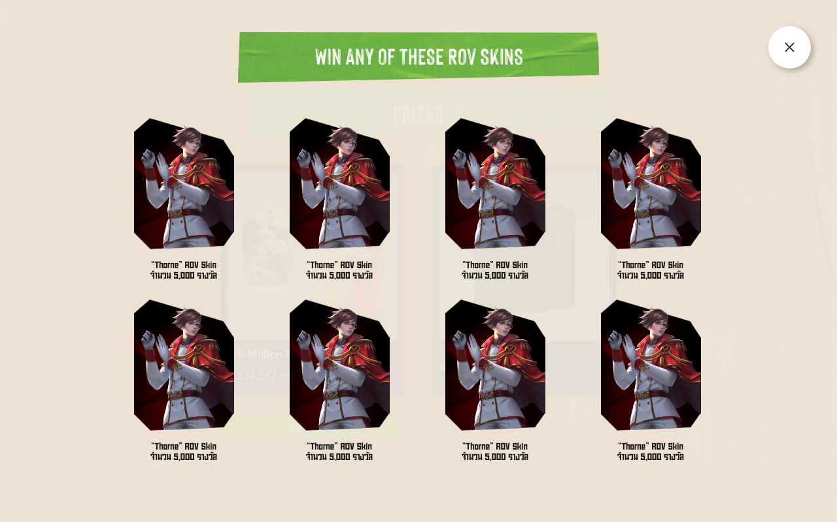


1. Masthead: will be TVC
2. Prize Highlight and How it Works combined into one section
3B. Prize Carousel POP UP– Pop up screen with details
3. Prize Carousel – removed Nintendo, added button for popup
Specific skins to be provided.
Copy to be provided.
4. Form – No Change

Slide 2
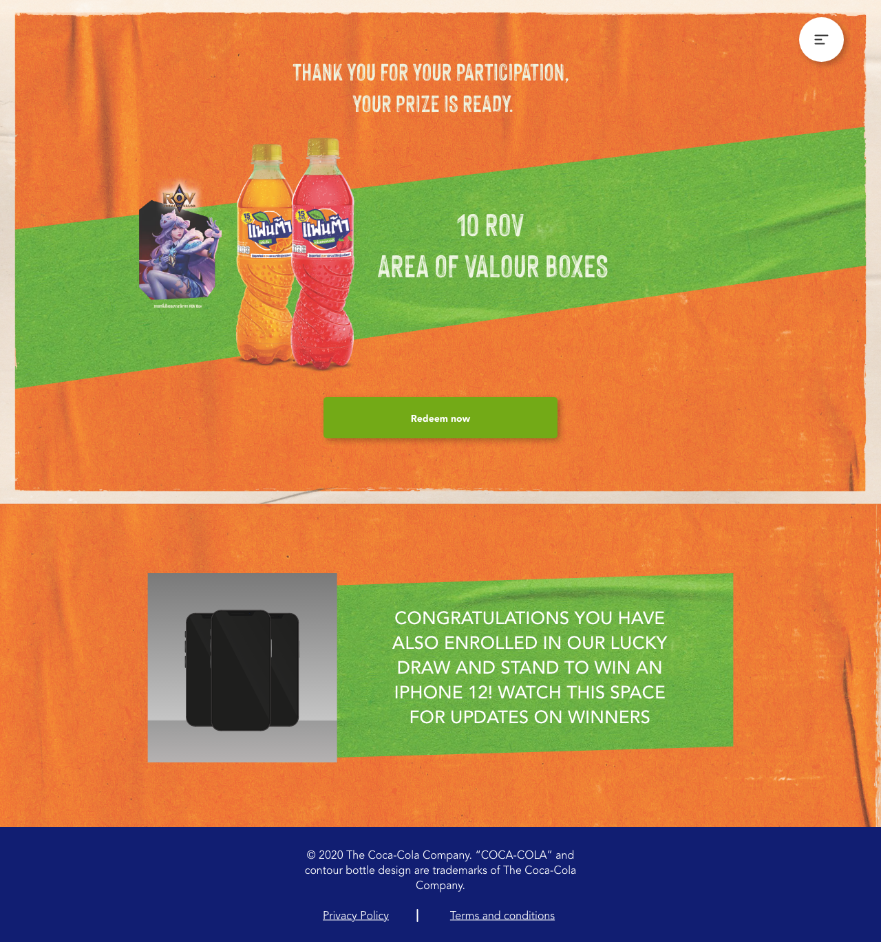
1. Masthead: will be TVC
2. Prize Highlight and How it Works combined into one section
3. Prize Carousel – removed Nintendo, added button for popup
4B. Prize Image – Lucky draw message added.
Copy to be provided.
4. Form – No Change

Slide 3
Page Flow
*view in presentation mode.

